Slide 1
Requirements elicitation, Requirements validation, Requirements change, Traceability Matrix
Management of Software Systems – Requirements Engineering

Slide 2
Requirements Engineering Processes
The processes used for Requirement Engineering vary widely depending on the application domain, the people involved and the organization developing the requirements
However there are a number of generic activities common to all processes
Requirements elicitation
Requirements analysis
Requirements validation
Requirements management,
In practice requirements engineering is an iterative activity in which these processes are interleaved

Slide 3
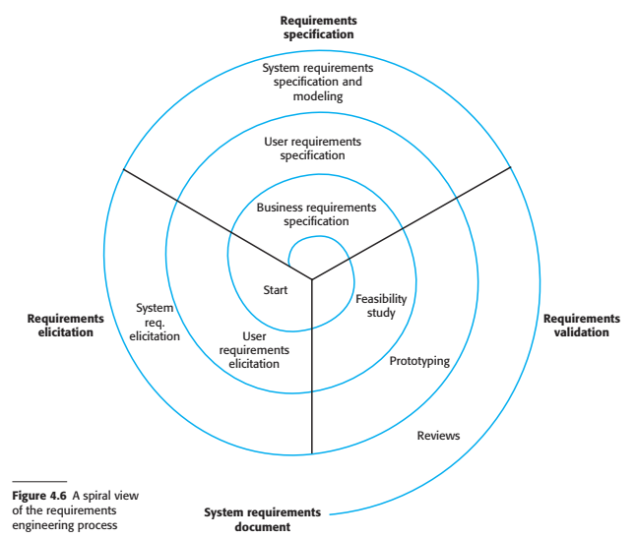
A spiral view of the requirements engineering processes

Slide 4
Requirements elicitation and analysis
Sometimes called requirements elicitation or requirements discovery
Involves technical staff working with customers to find out about the application domain, the services that the system should provide and the system’s operational constraints
May involve end users, managers, engineers involved in maintenance, domain experts, trade unions etc. These are called stake holders

Slide 5
Problems of requirements analysis
Stake holders don’t know what they really want
Stakeholders express requirements in their own terms
Different stakeholders may have conflicting requirements
Organizational and political factors may influence the system requirements
The requirements change during the analysis process. New stakeholders may emerge and the business environment may change

Slide 6
Requirements elicitation and analysis
Software engineers work with a range of system stakeholders to find out about the application domain, the services that the system should provide, the required system performance, hardware constraints, other systems etc.
Stages include
Requirements discovery
Requirements classification and organization
Requirements prioritization and negotiation
Requirements specification

Slide 7
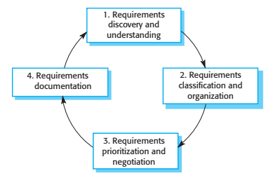
Requirements elicitation and analysis process

Slide 8
Process activities
Requirements discovery
Interacting with stakeholders to discover their requirements. Domain requirements are also discovered at this stage
Requirements classification and organization
Groups related requirements and organizes them into coherent clusters
Prioritization and negotiation
Requirement specification
Prioritization requirements and resolving requirements conflicts
Requirements are documented and input into the next round of the spiral

Slide 9
Requirements discovery
The process of gathering information about the required and existing systems and distilling the user and the system requirements from this information
Interaction is with system stakeholders from managers to external regulators
Systems normally have a range of stakeholders

Slide 10
Stakeholders in MHC-PMS
Patients whose information is recorded in the system
Doctors who are responsible for assessing and treating patients
Nurses who coordinate the consultations with doctors and administer some treatments
Medical receptionists who manage patients’ appointments

Slide 11
Stakeholders in MHC-PMS
IT staff who are responsible for installing and maintaining the system
Medical ethics manager who must ensure that the system meets current ethical guidelines for patient care
Healthcare managers who obtain management information from the system
Medical record staff who are responsible for ensuring that system information can be maintained and preserved and that record keeping procedures have been properly implemented

Slide 12
Interviewing
Formal informal interviews with stakeholders are part of most RE processes
Types of interviews
Closed interviews based on pre-determined list of questions
Open interviews where various issues are explored with stakeholders
Effective interviewing
Be open-minded avoid pre-conceived ideas about the requirements and are willing to listen to stakeholders
Prompt the interviewee to get discussions going using a springboard question, a requirement proposal, or by working together on a prototype system

Slide 13
Interviews in practice
Normally a mix of closed and open ended interviewing
Interviews are good for getting an overall understanding of what stakeholders do and how they might interact with the system
Interviews are not good for understanding domain requirements
Requirements Engineers cannot understand specific domain terminology
Some domain knowledge is so familiar that people find it hard to articulate or think that it is not worth articulating

Slide 14
Scenarios
Scenarios are real life examples of how a system can be used
They should include
A description of the starting situation
A description of the normal flow of events
A description of what can go wrong
Information about other concurrent activities
A description of the state the scenario finishes

Slide 15
Use cases
Use cases are a scenario based technique in the UML which identify the actors in an interaction and which describe the interaction itself
A set of use cases should describe all possible interactions with the system
High level graphical model supplemented by more detailed tabular description
Sequence diagrams may be used to add detail to use cases by showing the sequence of event processing in the system

Slide 16
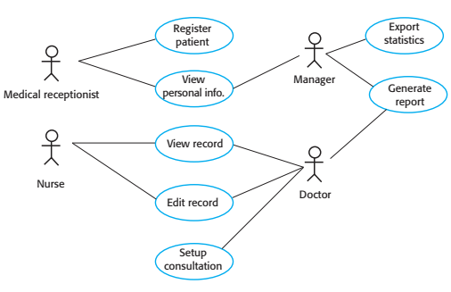
Use cases

Slide 17
Ethnography
A social scientist spends a considerable time observing and analyzing how people actually work
People do not have to explain or articulate their work
Social and organizational factors of importance may be observed
Ethnographic studies have shown that work is usually richer and more complex than suggested by simple system models

Slide 18
Scope of Ethnography
Requirements that are derived from the way that people actually work rather than the way the process definitions suggest that they ought to work
Requirements that are derived from cooperation and awareness of other people’s activities
Awareness of what other people are doing leads to changes in the ways in which we do things
Ethnography is effective for understanding existing processes but cannot identify new features that should be added to a system

Slide 19
Focused Ethnography
Developed in a project studying air traffic control process
Combines ethnography with prototyping
Prototype development results in unanswered questions which focus the ethnographic analysis
The problem with ethnography is that it studies existing practices which may have some historical basis which is no longer relevant

Slide 20
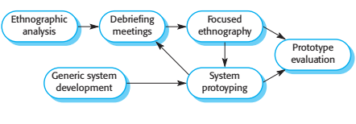
Ethnography and prototyping for requirements analysis

Slide 21
Requirements validation
Concerned with demonstrating that the requirements define the system that the customer really wants
Requirements error costs are high so validation is very important
Fixing a requirement error after delivery may cost upto 100 times the cost of fixing an implementation error

Slide 22
Requirements checking
Validity
Does the system provide the functions which best support the customer’s needs
Consistency
Are there any requirements conflicts ?
Completeness
Are all functions required by the customer included ?
Realism
Can the requirements be implemented given available budget and technology
Verifiability
Can the requirements be checked

Slide 23
Requirements validation techniques
Requirements reviews
Systematic manual analysis of the requirements
Prototyping
Using an executable model of the system to check requirements
Test-case generation
Developing tests for requirements to check testability

Slide 24
Requirements reviews
Regular reviews should be held while the requirements definition is being formulated
Both the client and the contractor staff should be involved in reviews
Reviews may be formal (with completed documents) or informal. Good communications between developers, customers and users can resolve problems at an early stage

Slide 25
Review checks
Verifiability
Comprehensibility
Traceability
Adaptability
Is the requirement realistically testable ?
Is the requirement properly understood ?
Is the origin of the requirement clearly stated ?
Can the requirement be changed without a large impact on other requirements?

Slide 26
Requirements management
Requirements management is the process of managing changing requirements engineering process and system development
New requirements emerge as a system is being developed and after it has gone into use
You need to keep tarck of individual requirements and maintain links between dependent requirements so that you can asses the impact of requirements changes. You need to establish a formal process for making change proposals and linking these to system requirements

Slide 27
Changing Requirements
The business and technical environment of the system always changes after installation
New hardware may be introduced, it may be necessary to interface the system with other systems, business priorities may change (with consequent changes in the system support required), and new legislation and regulations may be introduced that the system must necessarily abide by.
The people who pay for a system and the users of that system are rarely the same people
System customers impose requirements because of organizational and budgetary constraints. These may conflict with end-user requirements and after delivery, new features may have to be added for user support if the system is to meet its goals

Slide 28
Changing Requirements
Large systems usually have a diverse user community, with many users having different requirements and priorities that may be conflicting or contradictory.
The final system requirements are inevitably a compromise between them and with experience, it is often discovered that the balance of support given to different users has to be changed.

Slide 29
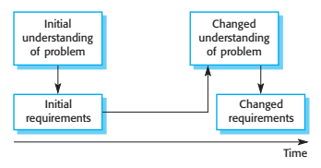
Requirements evolution

Slide 30
Requirements management planning
Establishes the level of requirements management detail that is required
Requirements management decisions
Requirements identification
Each requirement must be uniquely identified so that it can be cross-referenced with other requirements
A change management process
This is the set of activities that assess the impact and cost of changes.
Traceability policies
These policies define the relationships between each requirement and between the requirements and the system design that should be recorded
Tool support
Tools may be used range from specialist requirements management systems to spreadsheets and simple database systems

Slide 31
Requirements change management
Deciding if a requirements should be accepted
Problem analysis and change specification
Change analysis and costing
Change implementation
During this stage, the problem or the change proposal is analyzed to check that is valid. This analysis is feedback to the change requester who may respond with a more specific requirements change proposal, or decide to withdraw the request
The effect of proposed change assessed using traceability information and general knowledge of the system requirements. Once this analysis is completed, a decision is made whether or not to proceed with the requirements change.
The requirements document and where necessary the system design and implementation are modified. Ideally, the document should be organized so that changes can be easily implementd

Slide 32

Requirements change management

Slide 33
Key points
Requirements for a software system set out what the system should do and define constraints on its operation and implementation
Functional requirements are statements of the services that the system must provide or are descriptions of how some computations must be carried out.
Non-functional requirements often constrain the system being developed and the development process being used. These might be product requirements, organizational requirements, or external requirements. They often relate to the emergent properties of the system and thereforeapply to the system as a whole.
The requirements engineering process includes requirements elicitation, requirements specification, requirements validation, and requirements management.
Requirements elicitation is an iterative process that can be represented as a spiral of activities—requirements discovery, requirements classification and organization, requirements negotiation, and requirements documentation.

Slide 34


